Slide 1


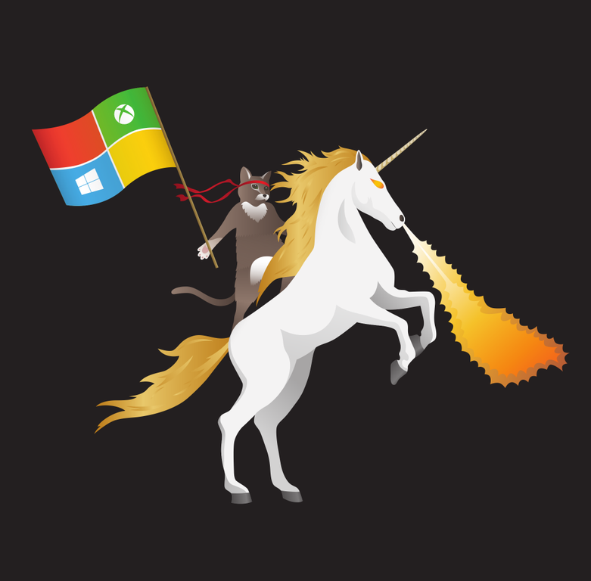
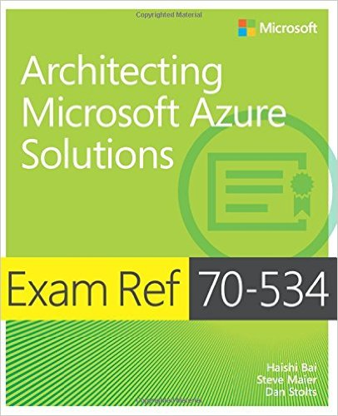



Blockchain
Spectre/Meltdown
DevOps
Docker/containers
Big Data/Analytics
Dan Stolts (@ITProGuru) Chief Technology Strategist US DX North East – Audience Blog: ITProGuru.com
dstolts@Microsoft.com
www.linkedin.com/in/danstolts
Specializations:
Cloud, Virtualization, Windows Server
Open Systems, Hybrid Cloud, Storage
aka.ms/70-534-book
@ITProGuru
Notes:
1:00 – 2:15: Private/Public/Hybrid, Blockchain, AI/IoT, Spectre/Meltdown: Microsoft Azure Cloud Keynote Dan Stolts, world-renowned Cloud Architect/Technology Evangelist at Microsoft and a dynamic/engaging presenter, is the featured keynote speaker. He will provide strategic and technical insights on these five highly relevant topics:
Dockers/containers: Architectural foundation for cloud-based applications and data
Blockchain: Open-Source digital contracts/ledgers with enterprise applications well beyond the Bitcoin hype
Spectre/Meltdown: Microsoft’s actions to protect cloud-based applications and data from chipset-based vulnerabilities
DevOps: Leveraging Azure services to support DevOps initiatives
Big Data/Analytics: Transforming raw data into valuable intelligence that drives improved business decision-making
Name of Presenter: Dan Stolts
Bio of Presenter (max 500 spaces): Dan Stolts “ITProGuru” is a technology expert who is a master of systems management and security. He is Chief Technology Strategist for Microsoft, owns several businesses and is a published author. Reach him on his primary blog http://itproguru.com or twitter @ITProGuru. He is proficient in many datacenter technologies (Windows Server, System Center, Virtualization, Cloud, Etc) and holds many certifications including MCT, MCITP, MCSE, TS, etc. Dan is currently specializing in system management, virtualization and cloud technologies. Dan is and has been a very active member of the user group community. Dan is an enthusiastic advocate of technology and is passionate about helping others. See more at: http://itproguru.com/about

Slide 2
Blockchain establishes a secure, shared source of truth
Data is stored in a ledger—
a record of every transaction
Everyone in the network has an individual, identical copy
The ledger can only be updated by network consensus, and information can’t be altered or deleted without the knowledge of the whole network.
Notes:
Note: This slide is animated. It does not require a click through.
So before we can get to changing the world, we have to understand the tool that we are going to use. So what exactly is blockchain?
Basically, it’s just a record of transactions. It’s just like the Excel spreadsheets and databases that you already use, but with one critical difference. That difference is that everyone on your network has their own identical copy of the record and the only way anyone can change it, is if everyone agrees on it.
Now that doesn’t mean everyone has to go in and hit the yes button for every single transaction, but it does mean that because of the way that information is added to it, any attempt to tamper with or mess with the data in any way, is easily spotted by everyone in the network and quickly identified as wrong.
T: Because you have all that visibility, you can always tell if the data is telling the truth.

Slide 3
Why does it matter for business?
There is massive opportunity to improve shared business processes:
$280B in banking industry fines since 2009
$21B cost of tax return fraud in the U.S.
48M illnesses from contaminated food
in the U.S. each year
Notes:
So you can see how that universal truth could have big implications for businesses.
Business is essentially based on trust. And trust can be pretty expensive to build and equally costly to lose. Anytime that you are collaborating with others, there is a certain amount of trust that you’re giving them. You could be trusting them to protect your customer data, you could be trusting them to not mishandle your shipments, you could be trusting them to perform services that you paid for. Regardless of the situation, you need a way to trust that they will fulfill their end of the contract.
Now traditionally, you’ve had to use intermediaries to sort of broker that trust for you to ensure everything is as it should be. That takes a lot of manual verification and checks just to make sure you get what you pay for.
The thing about blockchain, the promise of blockchain, is to sort of remove that unnecessary friction by getting rid intermediaries and acting as the trust broker itself. You remove the middleman and all the steps associated with them and you get a very fast, streamlined process that you couldn’t have before.
T: That’s really what’s got us so excited about this technology.

Slide 4
Customers typically have four key questions when starting any blockchain project
Is blockchain the right fit?
What do I need to get started?
How do I connect to my existing infrastructure?
What barriers should I expect along the way?
Notes:
So, this is the general journey format that most of our customers find themselves in. These 4 questions kind of reflect the state of mind that you’ll be at during each step, and naturally, we have an opinion on each one.
T: So let’s dive in.

Slide 5
When your project meets certain criteria
Answering a few questions can determine if blockchain
is appropriate
Is this a business process that crosses trust boundaries?
Do multiple parties work off of the same data?
Are there any intermediaries that control the single source of the truth?
Does the process involve low-value, manual verification steps?
Is blockchain the right fit?
Notes:
So, I think the first step is to ask yourself these four questions, which is where we start with most of our customers looking at blockchain.
The first is, is this a business process that crosses trust boundaries? And by that I mean, are there multiple groups that don’t necessarily trust each other? These could be different companies, customer, or even departments within your own company. Regardless, these are groups who are passing information across organizational boundaries.
The second question is, are there multiple parties sharing or updating the same data? That is, do all these groups have the ability to alter the data? Many hands in the cookie jar.
ALTERNATE 1: Are you looking at shared control of data rather than sharing of data?
Next you have to identify if there are any intermediaries in the process that are acting as brokers of trust. Where are you losing efficiency? Think of a clearinghouse in the financial services sector as a excellent example of this.
ALTERNATE 1: Will control of data by rules vs by power make a difference?
ALTERNATE 2: Are you thinking enforcement of rules by participants?
And, finally, if you are avoiding these intermediaries, are you using any low-value, manual verification steps in their place? I’m talking about those precautions that keep everything sorted, but also cause a lot of friction and slow down along the way.
T: So, if your process fits this template, we can then begin looking at your use case and the particulars for your specific industry.

Slide 6
Choose a foundation that enables you to…
Use the technology that best meets your needs
Deploy in the topology of your choice
Scale without limits as your business changes
What do I need to get started?
Notes:
To start off, you really need a solid foundation that you can build on. It’s got to give you some flexibility to match your needs and choose the right topology for where you are, and it’s got to be able to grow and develop to keep up with you too.
T: So let’s dive in to what it means to find the best-fit technology.

Slide 7
Why isn’t everyone using blockchain right now?
Ledgers designed for public networks
Lack the performance, confidentiality, and governance capabilities needed for commercial use
Smart contracts demand bespoke development and new skills
Not designed to leverage existing enterprise tools and skill sets
Integration is difficult and costly
Connecting to existing IT architecture requires significant investment
Notes:
Well you might have guessed, but this is a nascent technology and the system isn’t perfect. There are specific scalability issues that you run into when you try to use this thing at the enterprise level.
Right now we can sum those up into three points. First, the public ledgers we have right now just weren’t built for commercial use. They’re slow, and they lack the confidentiality and governance capabilities to be of any good use for enterprise. Second, to be really effective, you need a bespoke approach and a new set of skills to run it, which really means you don’t get to leverage all the enterprise tools you’re using right now. And finally, it’s just expensive.
T: This is a new technology, and it can be costly to build and to make it work with your current infrastructure.

Slide 8
Choose the topology that fits your needs
1
Dev/Test: Enable developers to get started
Single node (virtual machine)
2
Single Member: Simulate production for multiple divisions within a single organization
Multi-node across single region
3
Multi-member: Collaborate between multiple divisions and organizations
Multi-node across multiple regions, Azure subscriptions, and/or organizations
Notes:
The second thing is depending on where you are in your journey, you may want to deploy your blockchain in different topologies. This could be a single node, sort of dev/test, just want to play with it, to building a single member, single node internal proof of concept.
This is followed by customers asking us ‘how can I deploy blockchain in a multi-member, multi-node topology so that I can start to build a consortium with some of my competitors or folks in my supply chain.
And so we will support any level of topology with the blockchains that are available in the Azure marketplace, and we’re constantly striving to add more complex topologies with some of the ledgers that are currently only supported in the dev/test stage.
T: And you’ll also want to be certain that the platform choices you made in the beginning are not going to hold you back in the future.

Slide 9
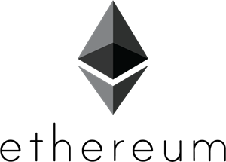

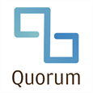
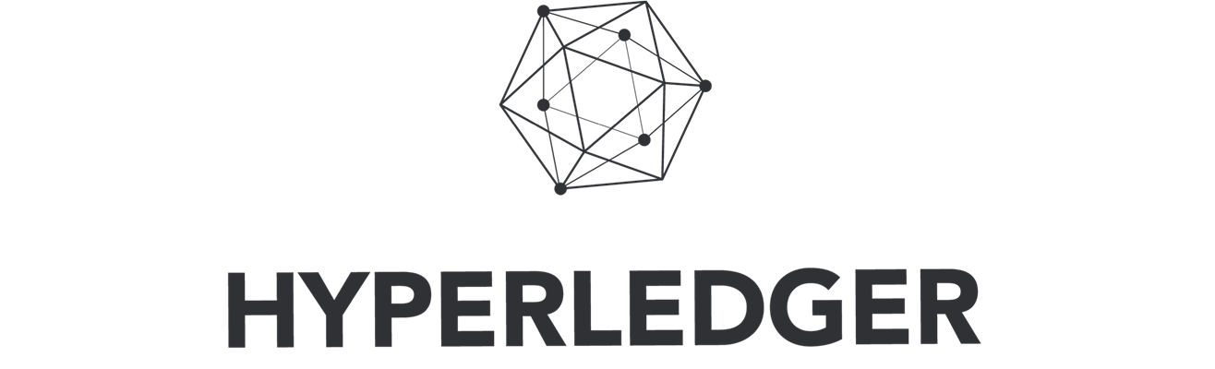
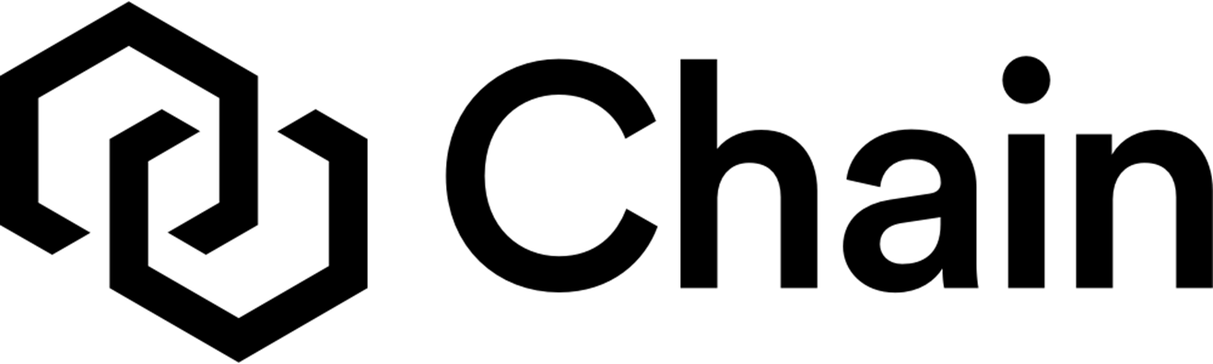
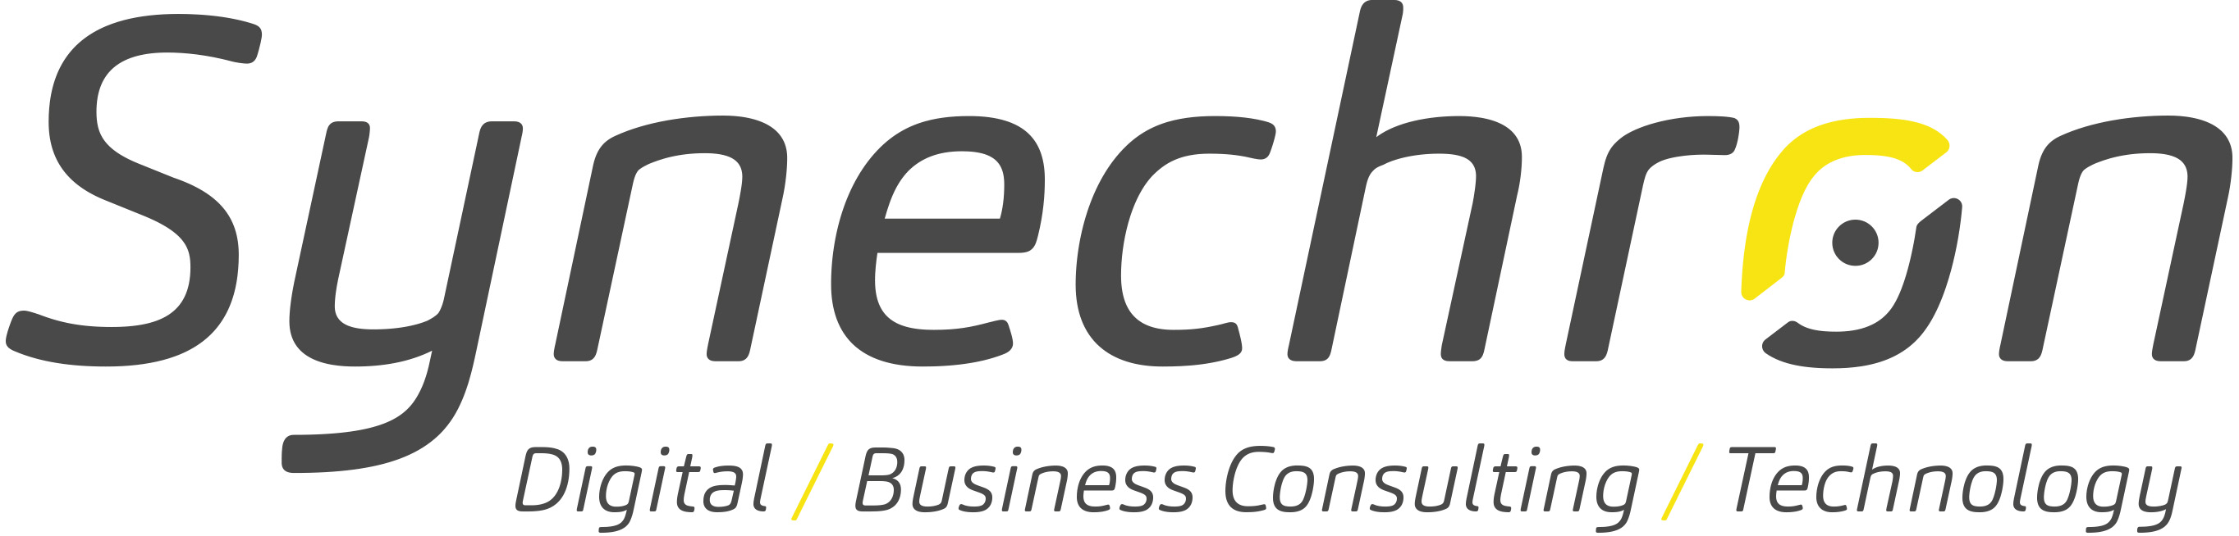
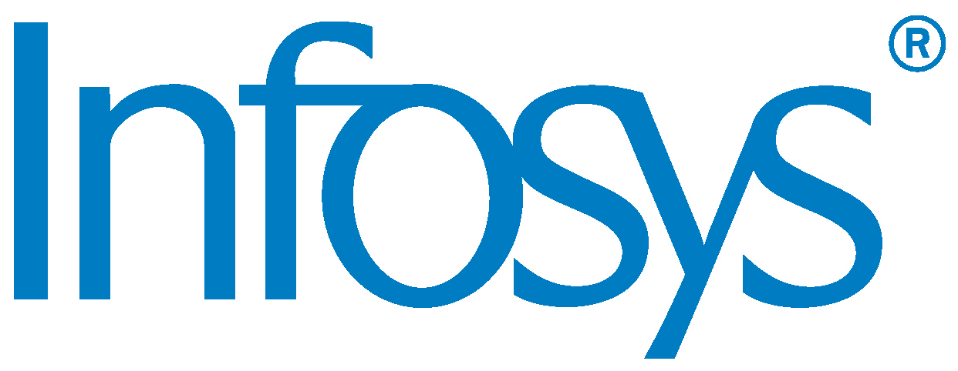


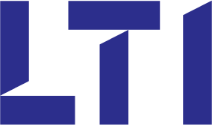
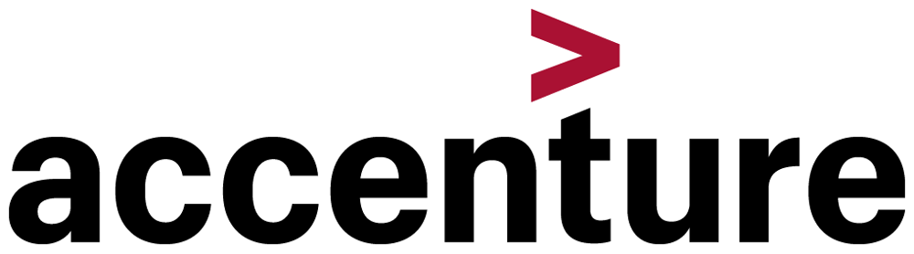

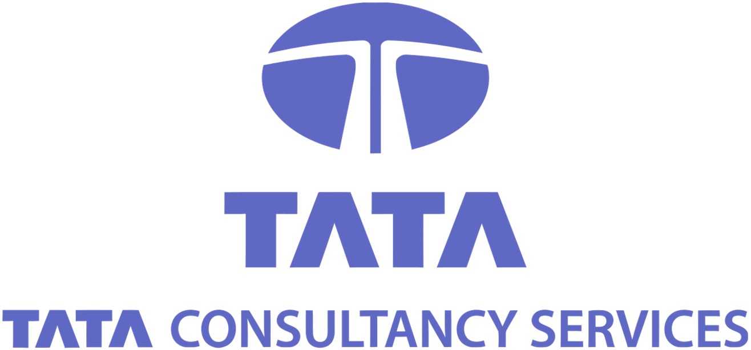
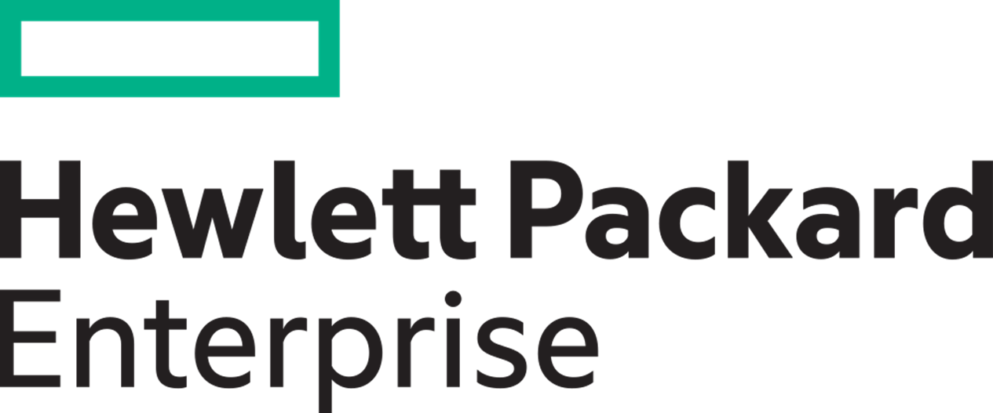

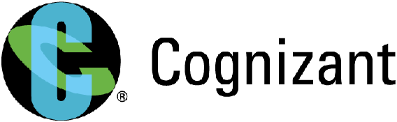




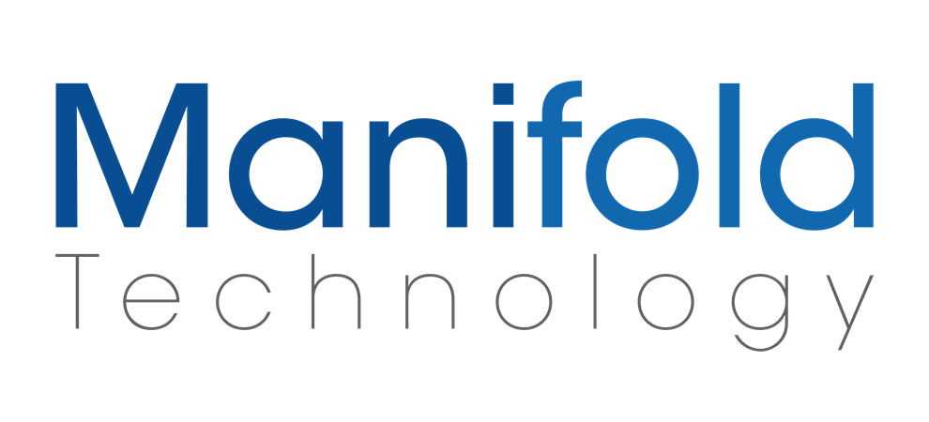


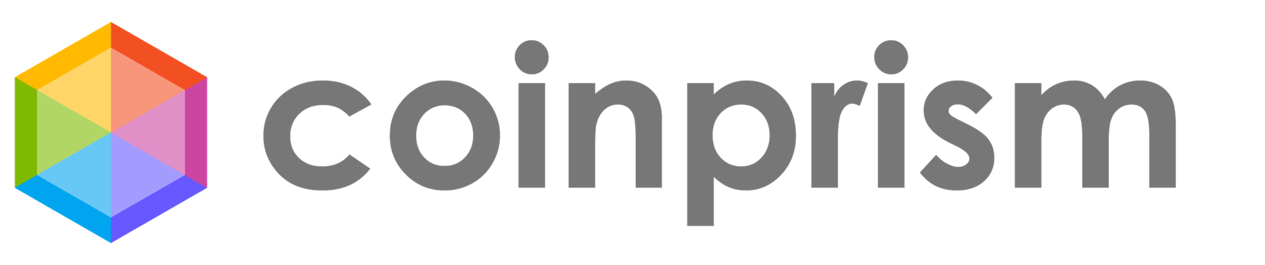
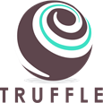



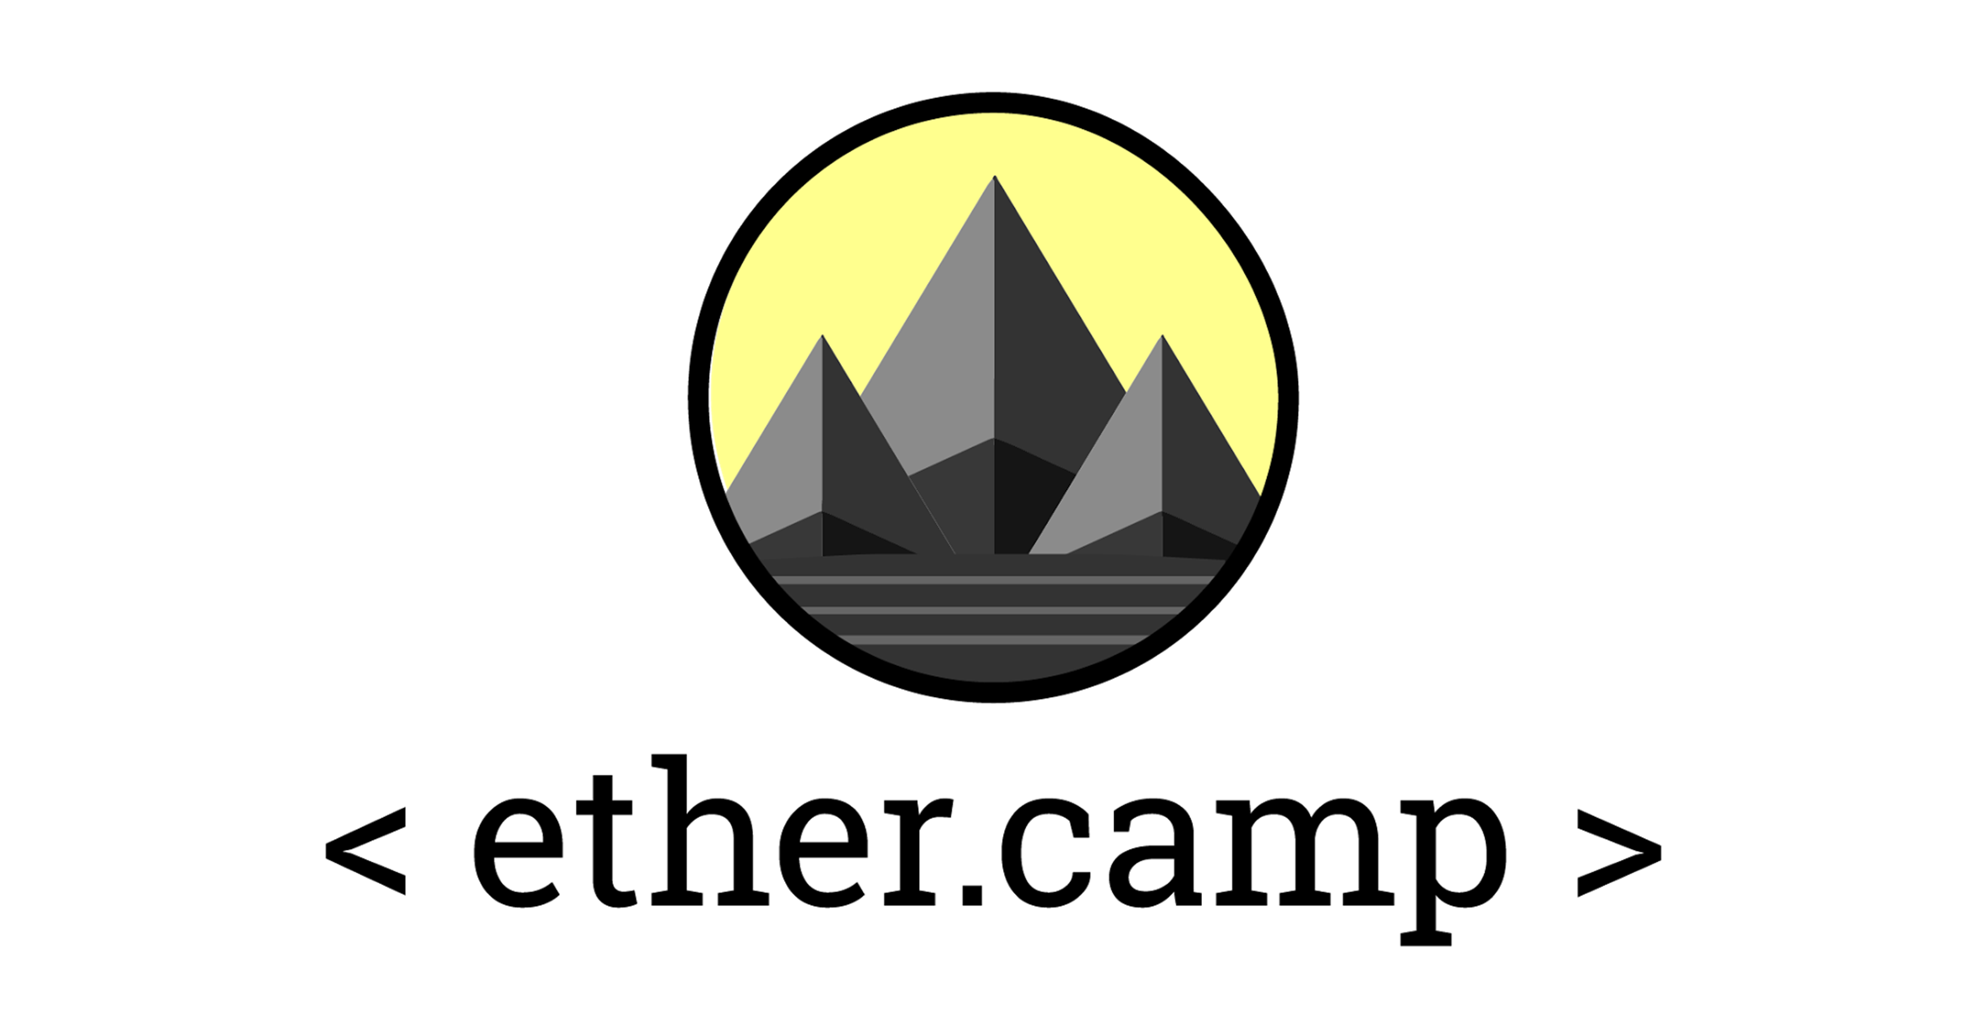


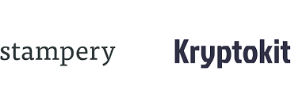
Take advantage of the largest ecosystem of blockchain partners
Ledgers
Partners
Dev Tools
Notes:
While we were working on our down digital transformation and doing all this extensive PoC work, we realized that Blockchain is definitely not a one-size-fits-all solution. Different customers require different ledgers for different purposes.
Here at Microsoft, you can work with a number of great ledger technologies to ensure that, regardless of your use case, you can build on the right foundation. You can have a general-purpose ledger like Ethereum or Hyperledger Fabric, or you can have something more specialized like Corda or Chain, which both work really well in the financial services sector.
We do this because our customers come to us all the time with different use-case-specific ledgers and we want to be ready to accommodate. We want to deliver the necessary tools to empower customers to get started on their own and experiment rapidly. That means being an open cloud platform for whichever ledger our customer wants to use.
T: The Azure marketplace has become an open hub for developers to not only access tools and resources to accelerate blockchain evolution, but also contribute by publishing their own templates.

Slide 10

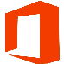


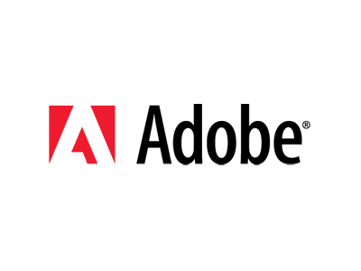
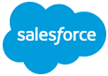
Leverage an enterprise-friendly platform
Banking, Capital Markets
Discrete Manufacturing
Retail & CPG
Healthcare
Government
Professional Services & Support
Connect to existing apps and workflows
Industry Solutions
Horizontal SaaS & Adapters
App Builder
Workflow Design & Orchestration
1st Party
3rd Party
…….
Developer Services (Tools, Team, CI/CD)
Off-chain Storage and Analytics
Secure Off-Chain Execution
Coordinate with relevant tools
Middleware
Identity & Key Management
Enterprise Integration
Monitoring & Security
3rd Party
Services
Fully-Managed Distributed Ledger
Hosted Compute (VMs)
Partner Distributed Ledger D
Partner Distributed Ledger E
Choose the ledger that fits your needs
Ledger Core
Partner Distributed Ledger A
Partner Distributed Ledger B
Partner Distributed Ledger C
Coco Framework
Azure & Azure Stack – Blockchain resource provider
How do I connect to my existing infrastructure?
Notes:
So what we did with this diagram here is give you a good visualization of what our strategy is with respect to blockchain, and how we envision sort of making it easier for customers like yourselves to build blockchain applications that are truly enterprise-grade.
So the first thing is when you look at the bottom layer of the stack here, you see what we're calling the ledger core.
The first thing we did is make it as easy as possible for you to deploy whatever network you care about, as easily as possible, on top of Azure. And so if you go to Azure marketplace today you can easily go and deploy Ethereum, Hyperledger Fabric Chain, or any of a whole bunch of different ledgers out there that we support across different topologies. That was step one. That's purely where you control your infrastructure yourself.
The next element here is something we're building to try to make your ledgers more managed, so now you don't have to deal with upgrading the blockchain network itself. Let us take care of it and give you the tools you need to manage it. So that's much more of like it has infrastructure at that point.
Then the next thing we're doing at that level is we're developing this Coco framework. This Coco framework is really going to help accelerate what you can do and what can develop on top of blockchain because it will address some of the big limitations of blockchain stacks out there such as its throughput and speed. Coco is currently still under development, but it will definitely be ready for deployment when you are.
That gives you sort of the infrastructure.
The next piece is connecting that to everything else that you care about. And that's when you move up the stack and you get in the middleware. Middleware enables your new ledgers to work the all the tools you’re already using.
So when you look at blockchain today, blockchain has its own concept of identity. It has public and private keys. So when you're looking at building an application on top of blockchain, the first thing you'll notice is a lot of applications today will require you to sort of authenticate using those public and private keys.
Now the problem is when you're sort of building an application that's enterprise-grade you're not going to want your customers or your users to know about the identity system that you guys are currently using. Whether it's Azure Active Directory, Google, or Facebook and you don't want them to also know about the blockchain identity.
So what we're doing is we're building up a set of middleware services that basically abstracts away the complexity of the identity system of blockchain because it's kind of different from each of the stacks. And abstracting that away and then leveraging Azure Active Directory, or any kind of third party, or even other types of identity management systems - and using that as your primary identity system for the blockchain itself.
The second piece is extracting information out of watching is very, very difficult today. So running analytics, running machine learning on it, visualizing that data is really difficult and so we're creating a set of services that really makes that a whole lot easier.
The secure off-chain execution is the whole concept of what we’re developing for the future that really tries to change the way that people think about business logic all up for our smart contracts and for blockchain.
And then lastly I would say as you move up to the top of the stack, we start thinking about these sort of integrations with 1st and 3rd party applications. That is, how do we integrate blockchain with Office 365, SAP, Dynamics, Salesforce kinds of applications? So, that’s what gives you an opportunity for building up these vertical and horizontal solutions that are geared towards really specific industries.
And one of the things that we have is something called the Azure Blockchain App Builder that I'm going to show you guys a demo of in a little bit. Essentially, what this application does is it will automatically build a full end-to-end application for your blockchain by giving it as input smart contracts or business logic. You give it business logic and you get a full end-to-end application that is fully integrated with a bunch of these middleware services.
T: But let me show you the simplified approach at a really high level in terms of architecture.

Slide 11
With a clear, simplified approach
Consuming Apps, Services & Systems
Power BI
Data Sources
DLT Services (API, Hashing, Signing)
Blockchain Ledger
APIs
API
Ingestion Hub
Off-Chain DB
Apps
Logic Apps
Off-Chain Storage
Event Hub
Sensors Data
Azure Functions
Reference Data
Azure AD
Azure Key Vault
Application Insights
Virtual Networking
*Internal MS Services analysis
Notes:
A lot of times when people are developing blockchain solutions there's a bunch of scaffolding work that people have to go do. Scaffolding work here is connecting it to a lot of the middleware services that I just mentioned before.
When we think about this, we've designed this app builder that sort of leverages this concept of some kind of ingestion hub like an event hub or a service bus, that's able to sort of be the entry point of information coming into the system.
And the way we have it set up is the information comes into the ingestion hub and we have it syncing with the blockchain. So writing out transactions into the blockchain and then syncing that data back out to an off-chain data stores locations, so syncing your information to like a SQL database for example.
And then at the same time being able to leverage integration points with other types of inputs, like IoT for example, with blockchain. So you have your sensor information coming in and participating in sort of your workflow and your blockchain network as well.
And then once everything is into sort of an off-chain stores location you can imagine being able to easily pull that information out and start creating interesting analytics and machine learning based on the information that's being pushed into the system.
T: So with that in mind I’m now going to show you guys a demo of a supply chain scenario.

Slide 12
Blockchain in Action: Freight Transportation
PRODUCER
Food Processor
Milk producer supplies Milk to Food Processing Company
The milk product is sealed in an IoT enabled package for shipping
The package has to be maintained at :
Temperature < 10º C
Humidity < 65%
SMART CONTRACT
CARRIER 2
Warehouse
CARRIER 1
The terms of shipping are registered using a smart contract on the Blockchain
11ºC
66%
SMART CONTRACT
UPDATED
Retail Store
The conditions of the contract have been violated.
Carrier 3 is liable for penalty as the temperature of the package when it reached the retail store was above the prescribed limit
SHARED LEDGER
Origin
Warehouse
Carrier 2
Store
8ºC
60%
9ºC
64%
9ºC
64%
11ºC
66%
IoT Enabled
At various points in the journey, the IoT device from the package sends the Temperature & Humidity data which are recorded on the blockchain
Notes:
In this particular case I'm going to talk about refrigerated transport. In this particular example, imagine we're transporting milk. So as we all know milk should be transported at a certain temperature range and a certain humidity range, otherwise the milk will spoil and will affect consumers downstream.
So super simple, you produce the milk, it's going through some kind of processing place, and then it gets transported from one carrier to another carrier to another carrier until it finally reaches the retail store.
And what we're doing is leverage the concept of IoT inside here. So IoT devices can keep track of your temperature and humidity and even potentially your GPS while you're transporting the goods to ensure that at every step away step along the way that the goods that are being sort of carried and transported and meeting compliance standards of transporting those goods.
T: So pretty simple and I'm going to show you guys how that actually all works.

Slide 13
You’ll need a re-imagined architecture
Presentation Layer
Presentation Layer
Presentation Layer
Business Logic
Cryptlets
(Business Logic)
Data Layer
Blockchain (Data Layer)
Blockchain (Data Layer)
Stored Procedures (Data Handling)
Smart Contracts
(Business Logic)
Smart Contracts
(Data Handling)
Traditional 3-Tier Software Architecture
Early blockchain Dapp architecture
Blockchain + Cryptlets
What barriers should I expect along the way?
Notes:
What we're designing is a way for people to execute business logic outside of the blockchain. And have that execution exist in a secured environment and have the results then get pushed back into the blockchain in a way that still maintains the integrity and security level of the blockchain itself. And what that really means is, instead of having your business logic be pushed into the data tier which it is today, you’ll have a layout more akin to this traditional 3-tier architecture you see in software.
So it's like me saying if you're going to run a database, put all your business logic into stored procedures. Which I'm sure of you guys would come look at me like I'm crazy to go do that. Well that's kind of how smart contracts work today. Instead of doing that, go ahead and write your business logic in whatever language and execute in whatever way you want to execute it. And still maintain that integrity of the office or of the blockchain through this concept of cryptlets that sort of drives the results back into the blockchain.
It's basically you're pulling that business logic away from the data tier and putting it into its own tier.
T: Which is kind of what you're used to in today's world when you're developing your applications from the presentation layer to a business layer to a data layer.

Slide 14
That leverages the patterns, tech, and talent you already trust
Securely call off chain data
Code in traditional languages with existing devs
Write once, use for multiple ledgers
Security
Productivity
Modularity
What barriers should I expect along the way?
Notes:
And the nice thing about that concept is by allowing you to write in whatever language you want, you're not limited by the language and the subset capabilities of the smart contract. And also by running it into your own sort of enclave or sort of secured environment, you're able to execute the code and whatever kind of computational power you need. So if you need to scale it up, let's say you're do some kind of data modeling or something like that, you're able to execute that and leverage your computational power that you need.
And so essentially, you're able to increase the security level of what you can actually accomplish with respect to your blockchain applications and actually increase the types of scenarios that you accomplish. Because now you can go grab data from outside. Your situation could run a lot more computationally expensive algorithms and workflows that they just couldn't do possibly before.
And you’re able to increase your productivity when you're developing your applications because now you can use whatever language you want.
And the other thing that's really nice is now you're not limited to a language per blockchain. You can write your language one time let's say in C# or Java or whatever it may be. And then have that business logic execute on any type of blockchain. So it makes your code a lot more modular and scalable with respect to whatever kind of blockchain stack you're working against.
T: So in summary, blockchain has some really exciting potential applications in a lot of different industries. But it’s also a nascent technology, and there’s journey that businesses will have to go on to really get the most out of it.

Slide 15
Microsoft is committed to your blockchain journey
Simplify development
Identify your use scenario
Select a ledger
Accelerate time to value
Write a smart contract
Innovate with confidence
Build and integrate your app
Notes:
I want to leave you with this; Microsoft is committed to this journey.
We're committed to bringing blockchain to enterprise based on a couple of principles. We want to simplify your development process. Whether it's in the cloud or on-prem, throughout your stack and with the blockchain of your choice, it needs to be integrated with your business. A lot of the work the engineering team is doing is connecting the blockchain to the IT assets and the existing infrastructure that you all are using today, so we can really accelerate your time to value.
And the third is it with the confidence to innovate. I said earlier in the discussion these tools were not necessarily built for enterprise but we can get them there and we have the platform that will make it well worth the wait.
T: So wherever you are in your blockchain journey I encourage you to come talk to us.

Slide 16

Azure Blockchain
Ledger and Topology Choice
Identity and Key Management
Secure Off-Chain Storage and Analytics
Monitoring and Security
Workflow Design and Orchestration
Enterprise Integration
Partner-Enabled Solutions
Trade Finance
Asset Registry
Supply Chain Provenance

Slide 17

Get started now
Model your workflow and accelerate development with the Azure Blockchain App Builder
Visit our Azure Blockchain Solutions Page
Learn more at the Azure Blockchain Blog
Contact your account team to connect with a blockchain expert
Join the conversation on Azure Advisors
Blockchain on Azure: https://azure.microsoft.com/en-us/solutions/blockchain/
Blockchain Template: https://github.com/Azure/azure-blockchain-projects/tree/master/bletchley Enterprise Smart Contracts (a.k.a. cryptlets): https://azure.microsoft.com/en-us/blog/cryptletsdd/
Notes:
So if you’re interested in learning more, please go ahead and start today. We’ve made it really simple to get started and you will learn so much by just diving in and getting your hands a little dirty.
(Thank you)

Slide 18
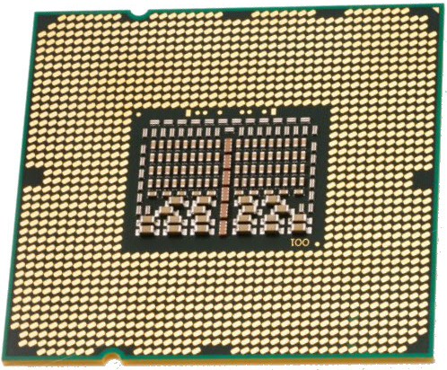


Speculative Execution Side-Channel Vulnerabilities Meltdown & Spectre
Intel, AMD, and ARM processors
Meltdown
Spectre
Supply Chain Attack (Hardware)
Meltdown breaks the most fundamental isolation between user applications and the operating system. This attack allows a program to access the memory, and thus also the secrets, of other programs and the operating system.
If your computer has a vulnerable processor and runs an unpatched operating system, it is not safe to work with sensitive information without the chance of leaking the information. This applies both to personal computers as well as cloud infrastructure. Luckily, there are software patches against Meltdown.
Spectre breaks the isolation between different applications. It allows an attacker to trick error-free programs, which follow best practices, into leaking their secrets. In fact, the safety checks of said best practices actually increase the attack surface and may make applications more susceptible to Spectre
Spectre is harder to exploit than Meltdown, but it is also harder to mitigate. However, it is possible to prevent specific known exploits based on Spectre through software patches.
https://spectreattack.com/
Dictionary.com “ghost; source of terror or dread”
007: SPecial Executive for Counterintelligence, Terrorism, Revenge and Extortion

Slide 19
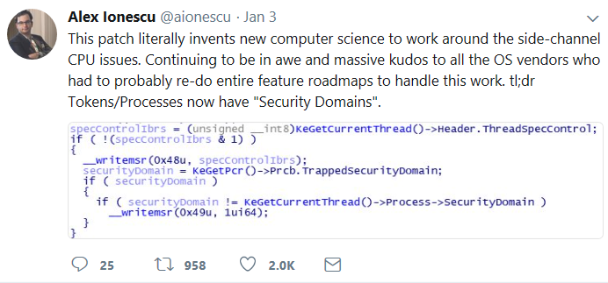
Speculative Execution Side-Channel Vulnerabilities & others in the Future!
What is it? Hardware Vulnerability
Information disclosure of Privileged Memory (usernames/passwords, encryption keys, etc)
Requires local code execution
Browser attack limited to browser memory (session, other tabs)
What you need to do
Patch Systems
Azure Monitor to get notifications
Security Center
Think Resiliency
Let Azure initiate maintenance when possible
Performance Impact!

Slide 20

Monitor, optimize and diagnose
Your Azure resources
from one place – the Azure portal
Azure Monitor
Azure Advisor
Azure Resource Health
Native monitoring and diagnostics for all your Azure resources
Monitor, diagnose, alert, and be notified of events in your cloud infrastructure
Personalized recommendation guide helping you follow best practices
Optimize across four areas -high availability, performance, security, and cost
Diagnose and get support when an Azure issue impacts your resources
Guides you through solutions to mitigate issues with Azure resources
https://aka.ms/azmonitor/
http://aka.ms/azureadvisor/
http://aka.ms/azureresourcehealth/

Slide 21
Azure Cloud Remediation
Dec 28th Controlled Emergency Maintenance Window Opened: +99% success rate on updates
Jan 3rd Vulnerability Leaked. Disclosed within 24 hours of the leak https://googleprojectzero.blogspot.com/2018/01/reading-privileged-memory-with-side.html
Accelerated patch and reboots https://docs.microsoft.com/en-us/azure/virtual-machines/windows/mitigate-se
Jan 7th Emergency Maintenance Window Closed
No additional action needed by customers
No significant complaints / some related to performance
Host Upgrades via Live Migration
VM’s updated based on Availability Sets and custom tool from Microsoft
Improvements to Planned Maintenance
New Availability Zones Created to combat future vulnerabilities
Tools Created (patch and reboot most
Provide more control to customers
Enable Retry
Support VM Scale Sets
Resource Health Activity Log and Alerts
In-VM notification of upcoming maintenance events
More
Many Lessons Learned! More advanced capabilities coming to reduce impact even more

Slide 22
Cloud Partnership
CUSTOMER
Balance of responsibility
Cloud architectures
Design for high-availability
Leverage Microsoft resources
MICROSOFT RESOURCES
Service resiliency guide
Cloud dev patterns & practices
Proactive and reactive support
CLOUD PLATFORM RELIABILITY
Availability, change orchestration, monitoring, communications, recommendations
Notes:
Azure Supportability = not in scope of this discussion

Slide 23






DevOps is the union of people, process, and tools to enable continuous delivery of value of our end uses.
DEV
OPS
1
People
2
Process
3
Tools
Shared Mission: Deliver a great product that inspires our customers to become raving fans
Notes:
People = Culture
Fundamental attributes of successful cultures:
Shared mission and incentives: infrastructure as code, apps as services, DevOps/all as teams
You need to consider your hardware as a commodity, (don't give your servers names) , servers are like farm animals, it is just harder if you let theids name them
Build deep instrumentation into services, push complexity up the stack
Rally around agile, shared metrics, CI, service owners on call, etc.
Changing the culture: any change takes time, changing culture is no exception and you can't do it alone, exploit compelling events to change culture: downtimes, cloud adoption, devops buzz
PROCESS Definition and design, compliance, and continuous improvement
PEOPLE Responsibilities, management, skills development, and discipline
Tools and infrastructure

Slide 24
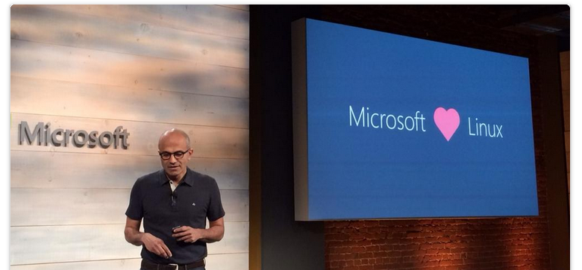
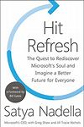

Culture Change & Digital Transformation
Open Source:
Power BI, PowerShell, Visual Studio Code… 1732+ More
Hit Refresh
The Quest to Rediscover Microsoft's Soul and Imagine a Better Future for Everyone
2017 - Satya Nadella, Greg Shaw, Jill Tracie Nichols - Biography & Memoirs
#1 Contributor on GitHub?

Slide 25
Value of DevOps
People:
Personal Self-worth
Confidence
Lower Stress
Higher Pay
Continuous Learning
Continuous Innovation
Higher Productivity
Culture of Working Together
More!
Business:
Higher Productivity
High Moral
Competitive Advantage
Speed to market
Continuous Innovation
Lower Costs
Culture of Trust
Culture of Innovation
Much More!
Systems:
Highly Scalable
Highly Resilient
Highly Performant
Right Sized
Fully Automated
CI/CD - Continuous Integration/ Continuous Deployment
Continuous Improvement
Much More!

Slide 26
Expected results
Decrease Application and Application hotfix/patch deployment time by many months
Teach your experts how they can use the latest technology to improve their results
Significantly reduce waste cycles in many aspects of the organization as it relates to technology and deployment
Work cross teams collaboratively
Get Hands-on solving the teams most challenging problems with Microsoft Sr Experts working side-by-side with them.
Increase DevOps journey speed and performance

Slide 27
DevOps Practices
Primary
Secondary
Infrastructure as Code (IaC)
Continuous Integration
Automated Testing
Continuous Deployment
Release Management
App Performance Monitoring
Load Testing & Auto-Scale
Availability Monitoring
Change/Configuration Management
Feature Flags
Automated Environment De-Provisioning
Self Service Environments
Automated Recovery (Rollback & Roll-Forward)
Hypothesis Driven Development
Testing in Production
Fault Injection
Usage Monitoring/User Telemetry
http://www.itproguy.com/devops-practices/

Slide 28
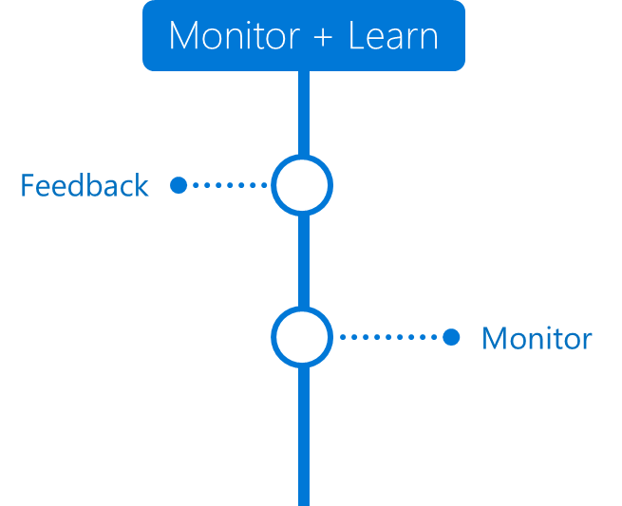
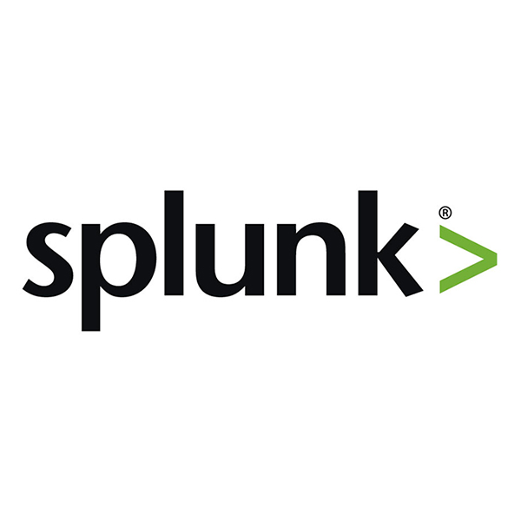
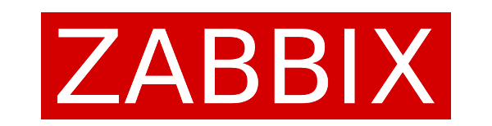
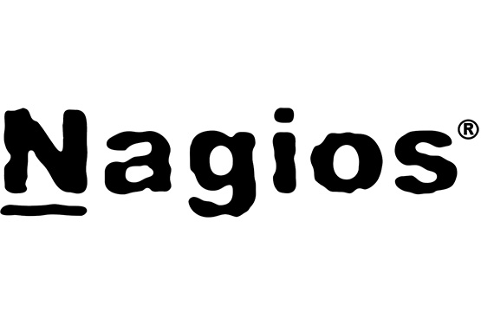
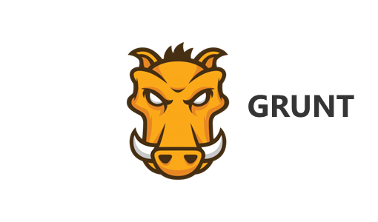
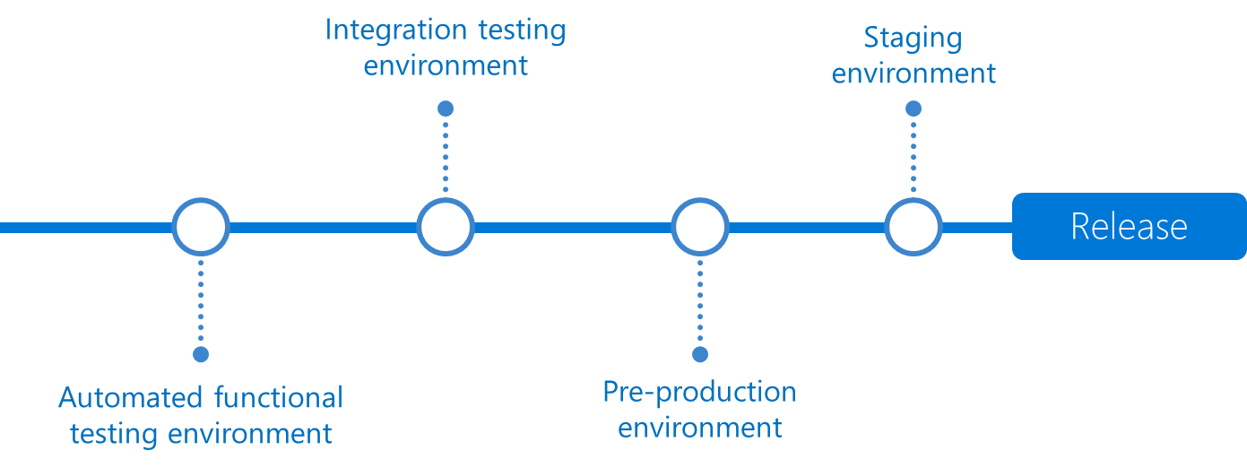
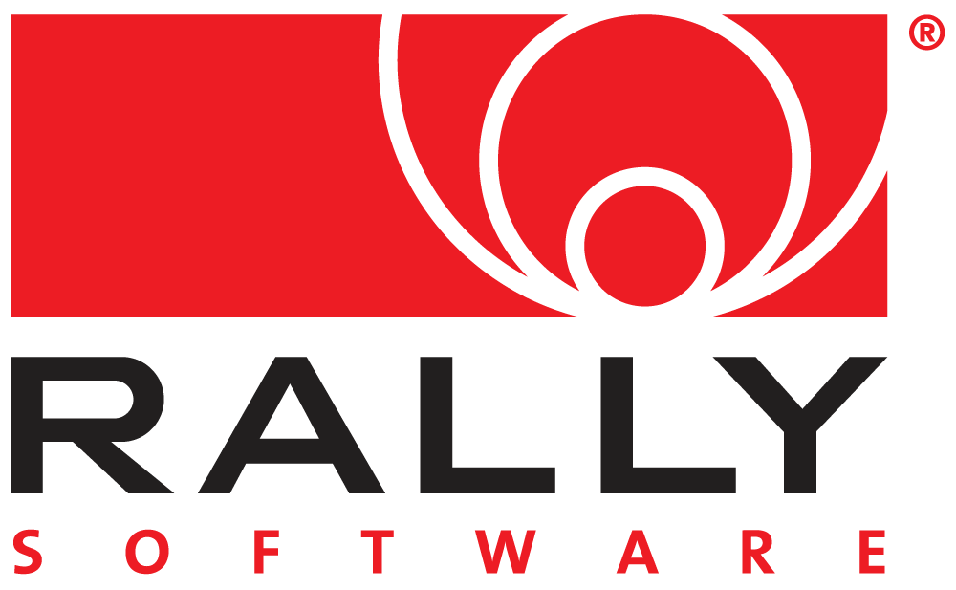
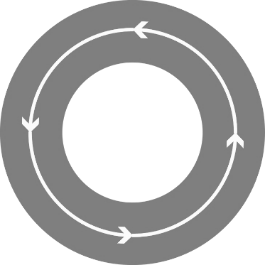
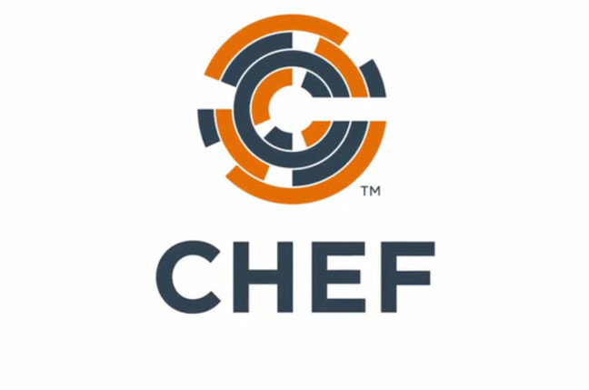
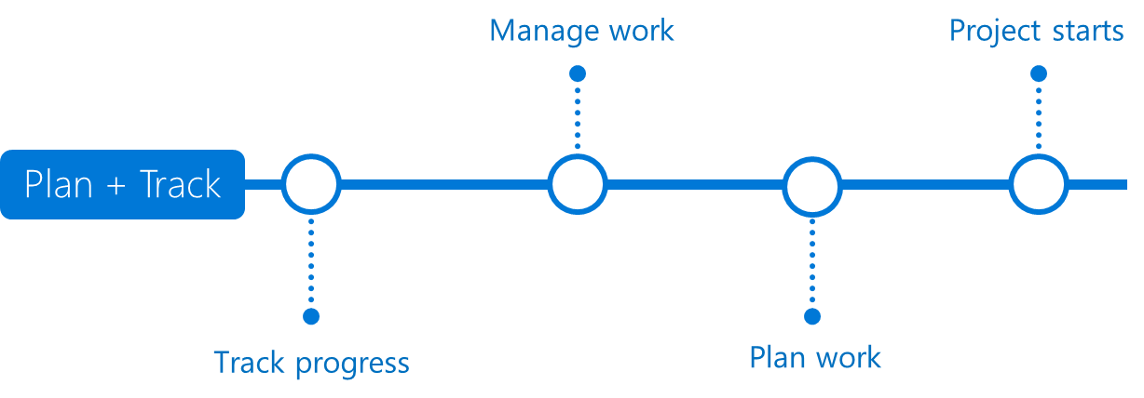


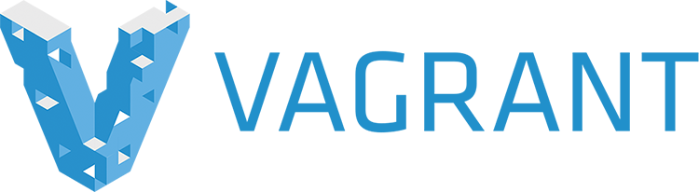




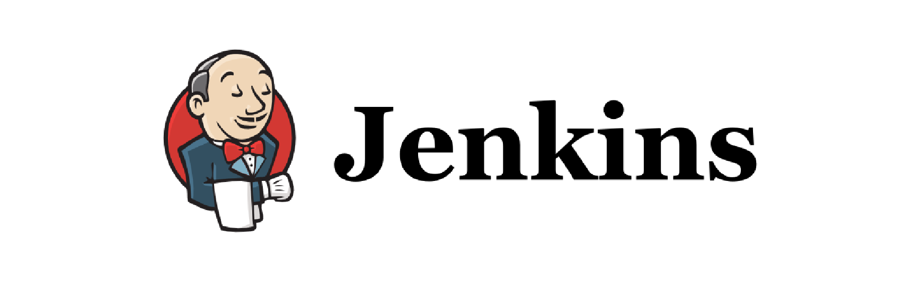
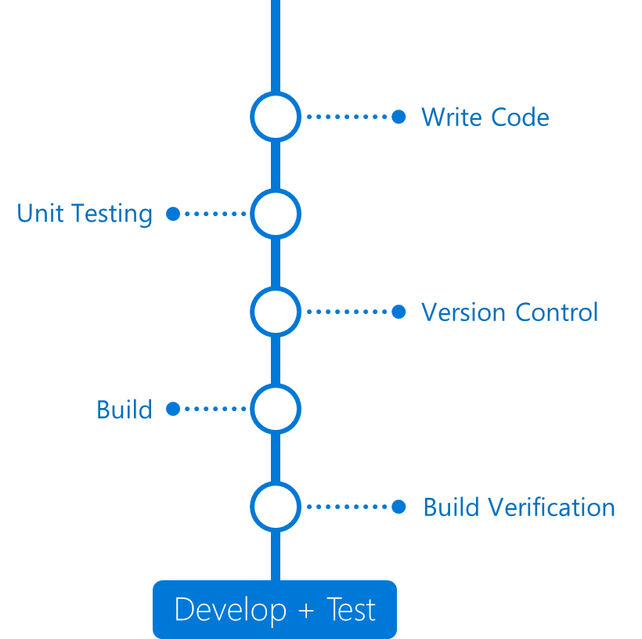
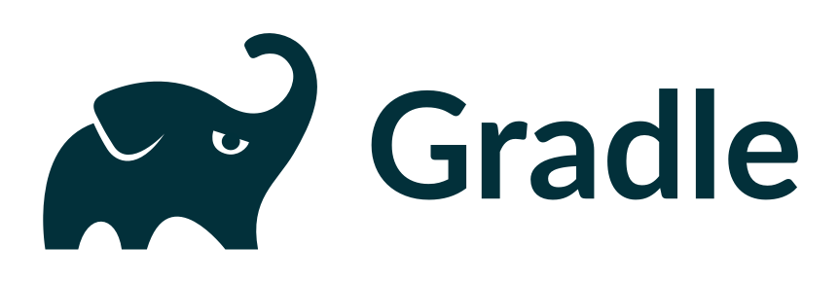
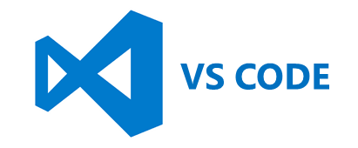
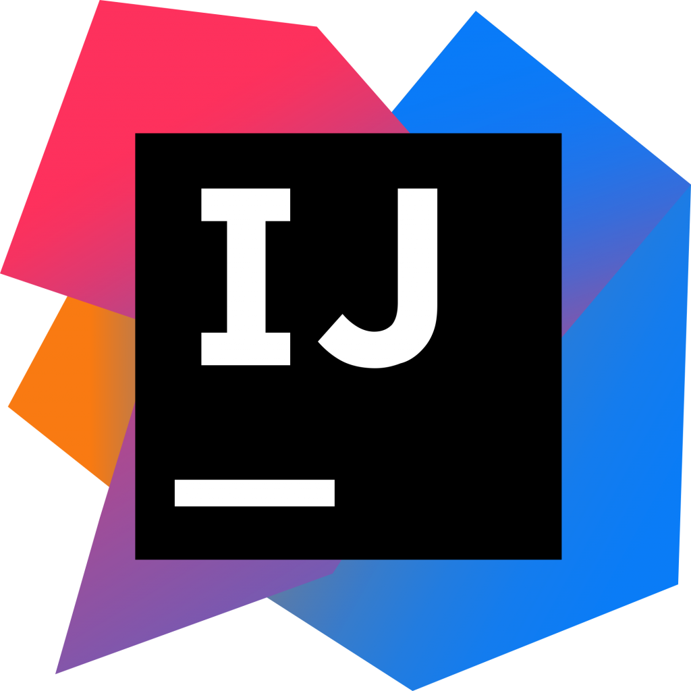
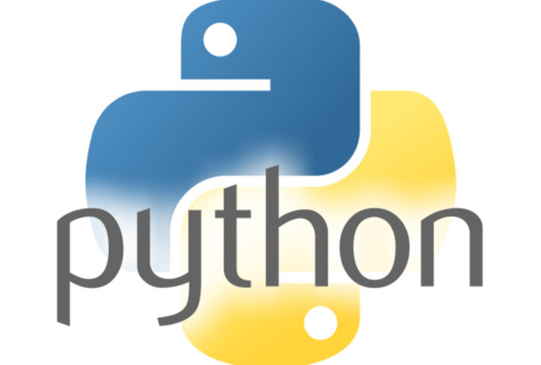
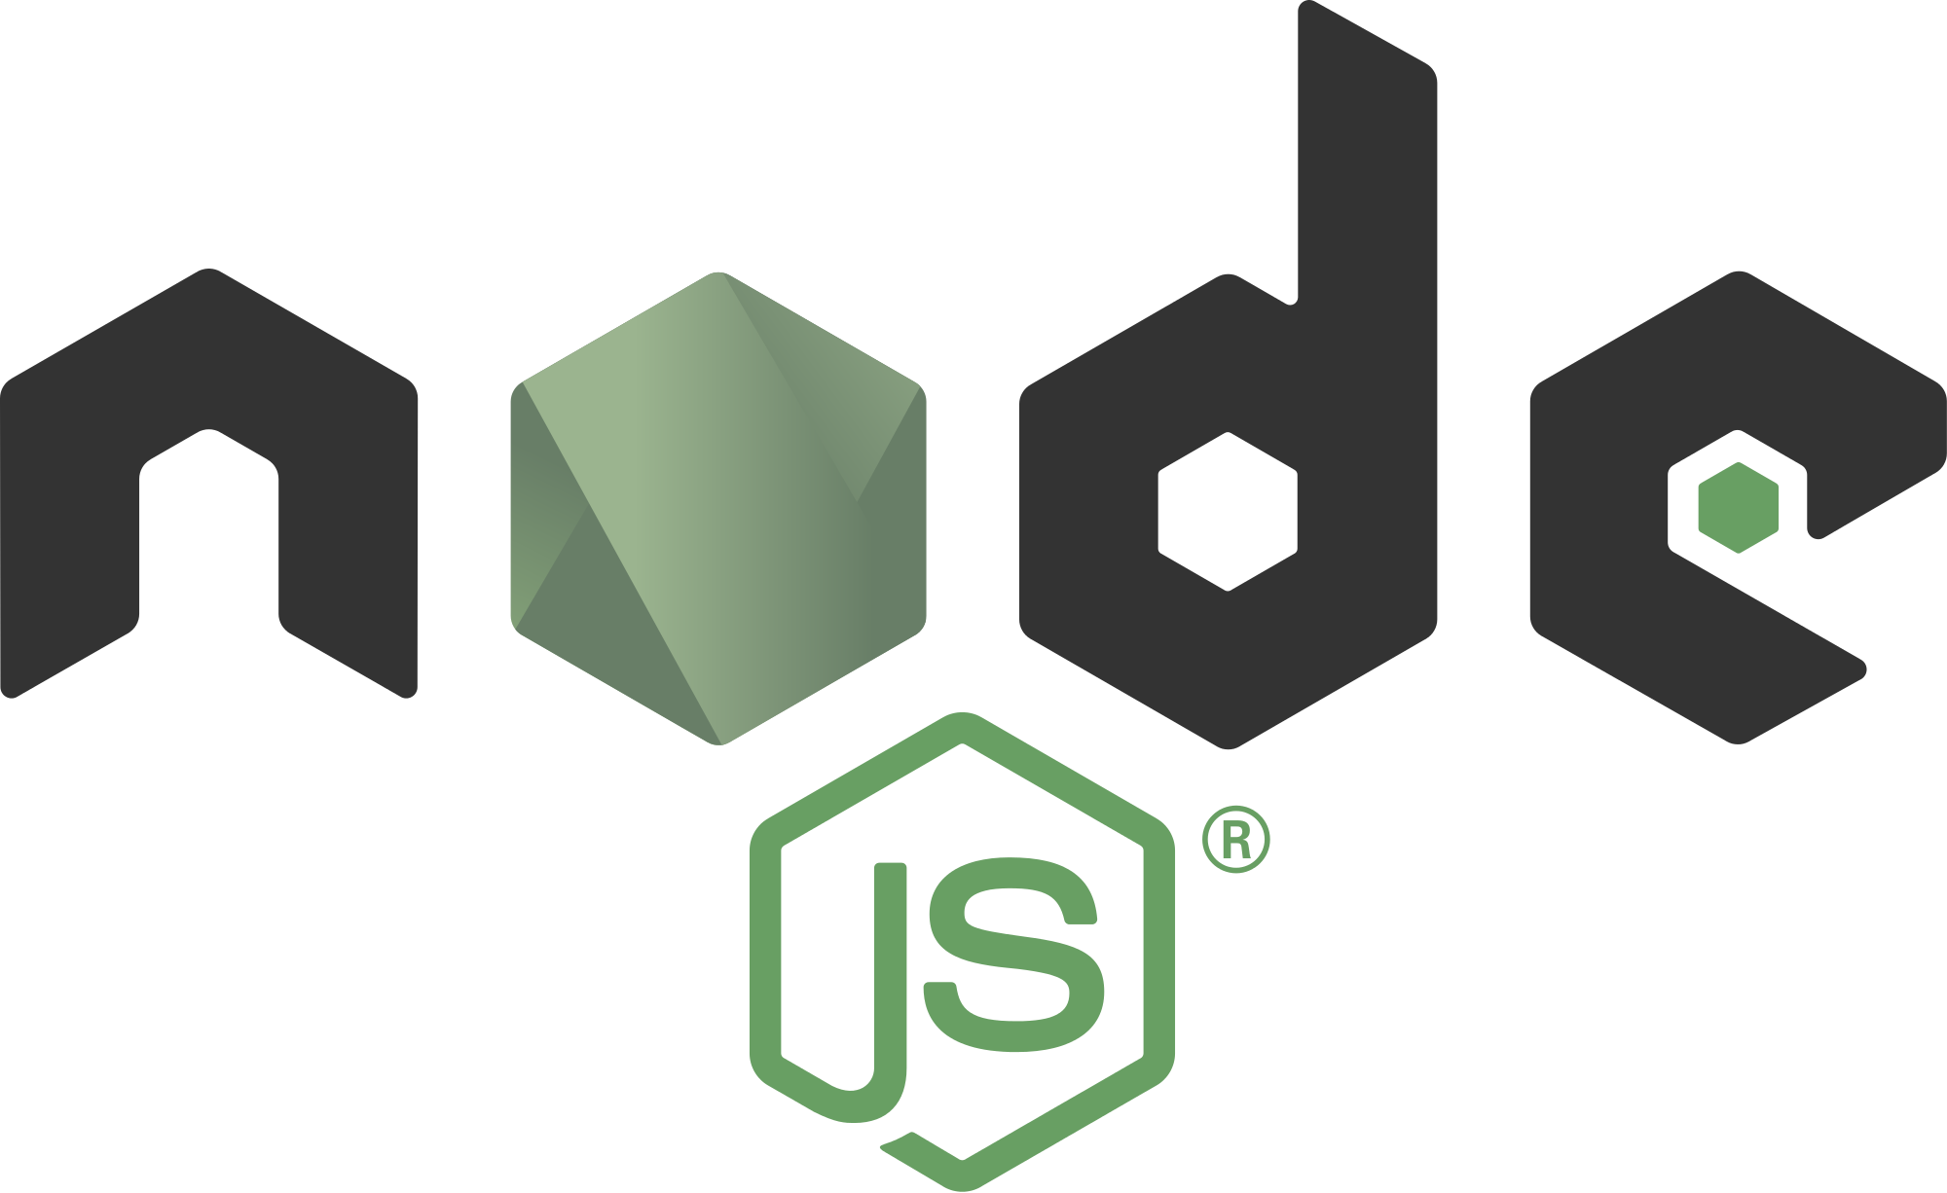
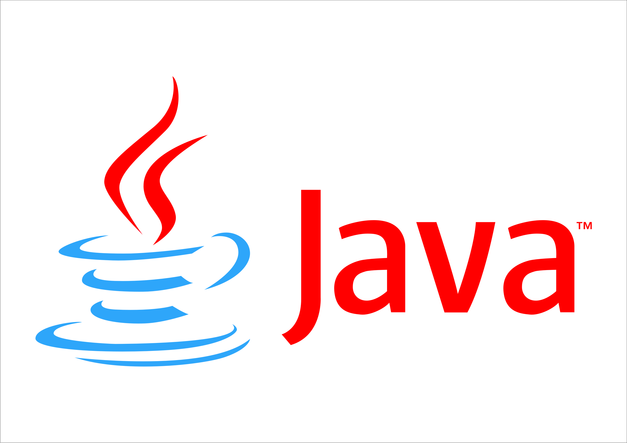

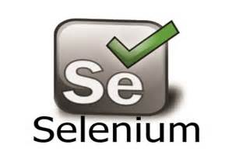
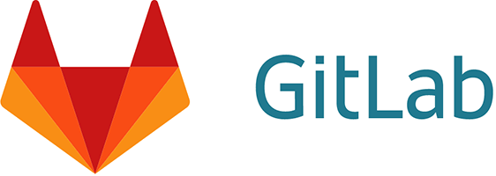
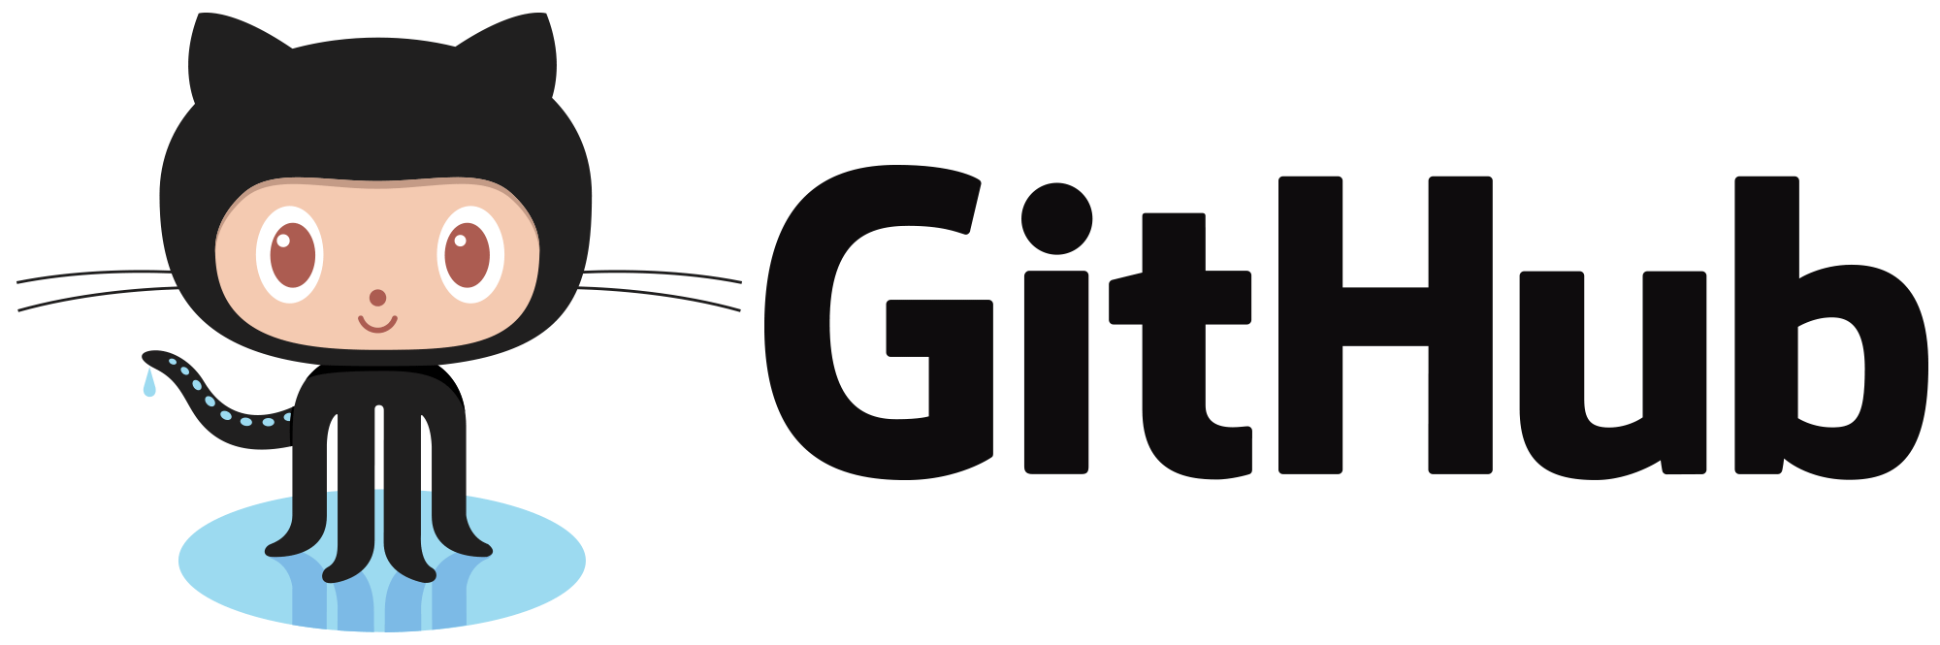
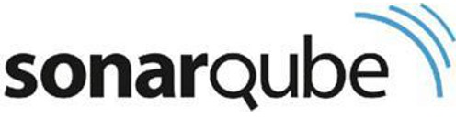
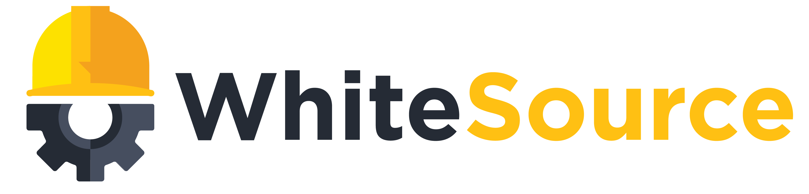
DevOps process
DevOps
DevOps

Slide 29
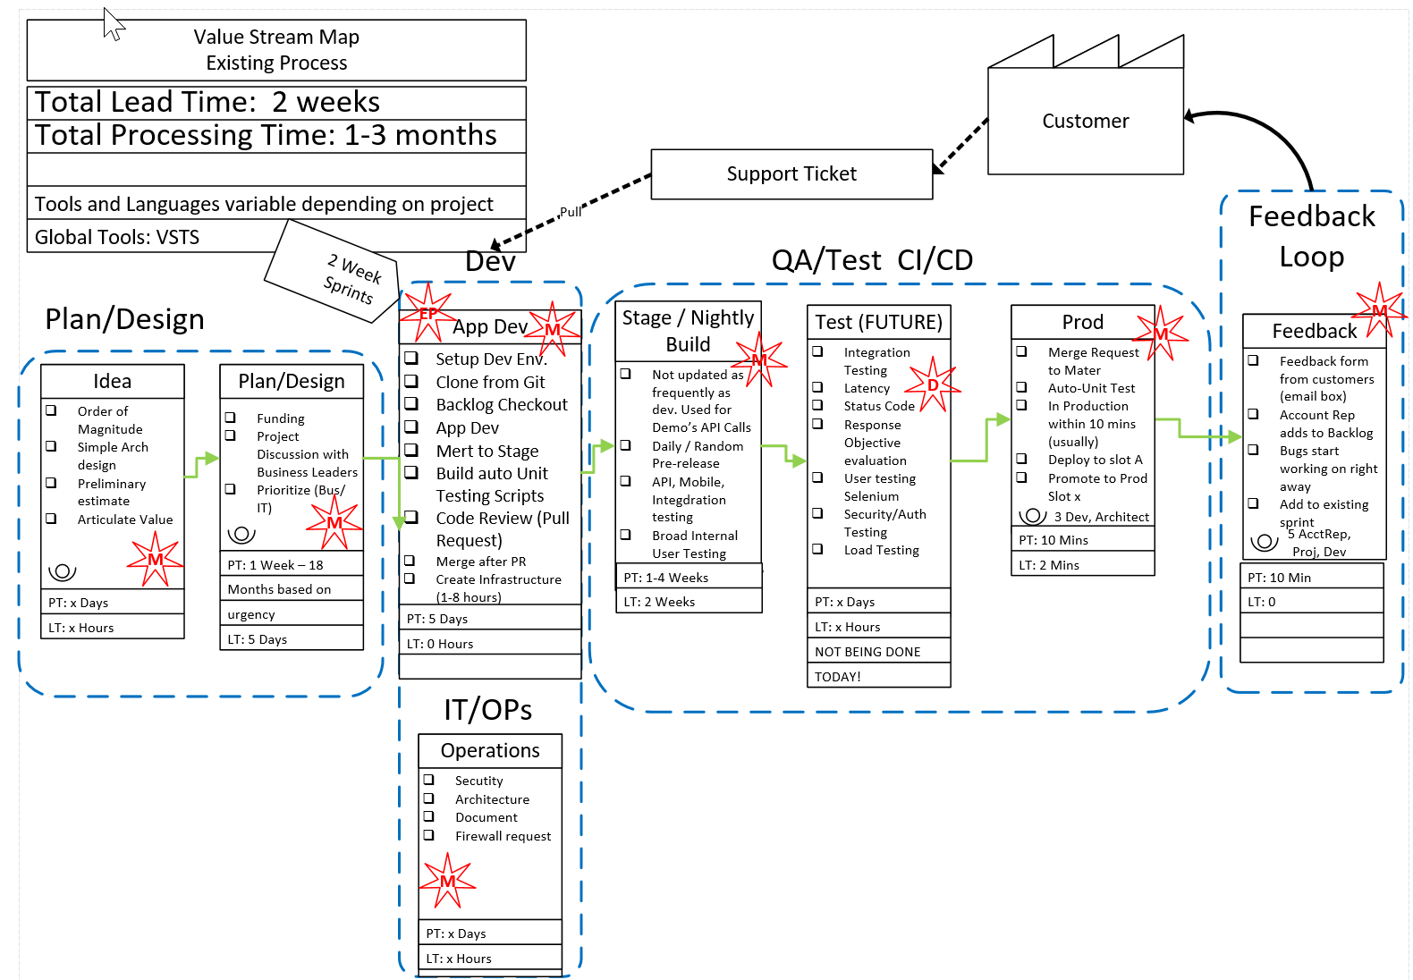
Before DevOps
How long does it take?
Where is the waste?
How much waste
Total time?
Homerun: Total Cost
2 Week Lead time
1-3 Months Processing
Waste in every step

Slide 30

Notes:
Explain in details the definition of couple of the wastes like “Heroic” or “Manual”.
Bring the slide back on the screen during the Waste analysis and recommendations.

Slide 31

After DevOps
2 Week Lead time
1 Day – 2 Weeks processing time
Not all waste was cut in first pass
Fully automated and streamlined process with an application flowing through the system.
Investment: 3 weeks

Slide 32

Release Cycle 18 months → 4 weeks Hotfix 6 week → Same Day Investment → 3 weeks

Slide 33
Containerization
ARM Template
2 Hosts
4 Instances of Container A
2 Instances of Container B
Container are… a technology that ENABLES and ACCELERATES DevOps
Abstract the unit of work from the VM
Lightweight, fast provisioning, density
Simplify application updates
Works with cluster managers for auto-scale capabilities
Container Host - 1
Container Host - 2
Container
A
Container
A
Container
A
Container
A
Container
B
Container
B
Orchestration Engine

Slide 34


What is a container?
Containers
Windows Server containers Maximum speed and density
= Operating system virtualization
OS
Container
Container
Container
Applications
Container
Container
Container
Kernel
OS
Hardware
Kernel
Traditional virtual machines = hardware virtualization
Hyper-V containers Isolation plus performance
Application
VM
VM
VM
Container
Container
Container
OS
Hardware
Kernel
Kernel
Kernel
Hyper-V

Slide 35

Microsoft: DEVOPS200.9x Architecting Distributed Cloud Applications

Slide 36
What is a container?
Package distribution mechanism – Shout out to acr here
MyApp.v2
MyApp.v2
Laptop/Dev Image Here
Azure Container Registry
Push
Pull

Slide 37
What is a container?
A clear boundary for your stuff
Operating
System
Web Server
Monitoring Agent
Log Roller
SSH Daemon

Slide 38
What is a container?
A clear boundary for your stuff
Operating
System
Web Server
Log Roller
SSH Daemon
Monitoring Agent

Slide 39
What is a container?
Runtime isolation
Production Web Server
Intern’s Minecraft Server

Slide 40








Session VS VM (or VDI)
OS, Apps, Config, Mgmt
EACH Workload
Single OS
All Workloads
OS
OS
OS
OS
Apps
Apps
Apps
Apps
Massive VM Overhead
(Disk, Disk IO, Memory, CPU, OS, Licenses, Density, The works)
OS
OS
OS
OS
Apps
Apps
Apps
Apps
OS
OS
OS
OS
workloads
Apps
Apps
Apps
Apps
OS
OS
OS
OS
Apps
Apps
Apps
Apps
Application(s)
Application(s)
Operating
System
Operating
System
Parent OS
Hardware Virtualization
Hardware Virtualization
Hardware / Hypervisor Level
Session Based Computing
VM or VDI Based Computing

Slide 41


Containers
Single OS
All Workloads
OS
EACH Platform
App
App
App
App
App
App
App
App
App
App
App
App
App
App
App
App
App
App
App
App
App
App
App
App
All Advantages of VM & Session
Isolation, Little overhead
workloads
App
App
App
App
App
App
App
App
Container / Image
App
App
App
App
Container Engine
App
App
Linux VM
Container / Image
Container
Container
Application(s)
Container Engine
Container Engine
Operating
System
Operating
System
Parent OS
Hardware Virtualization
Hardware Virtualization
Hardware / Hypervisor Level
Container Based Density Advantages
Container Based Computing VM Isolation

Slide 42
Containers Deep Dive: Architecture of a Host
App
App
App
App
App
App
App
App
App
App
Copy on Write
Any layer that is SAVED or Downloaded is locked
Any workload
New Blank is created to allow write
Container Engine
Engine and Orchestration are different jobs, not always different products
Any workload can be set as a BASE by saving
It can then be used as a base, All required pieces below it will automatically be deployed
App
App
App
App
App
Web Sites
Web Site
Web App
App
App
Container Orchestration
Web Engine Config
IIS Config
Web Engine Config
Web Engine Base (IIS installed)
OS Base (eg. Nano)
Container Engine (Windows, Linux, Docker)
Operating
System
Hardware Virtualization

Slide 43



Azure Container Service
Azure Container Service
Making containers in Azure EZ!
Standard Docker tooling & API Support
Streamlined provisioning of K8S, DCOS, and Docker Swarm
Linux & Windows Server Containers
Azure & Azure Stack
ACS --> AKS (Preview)
Focus on Kubernetes
Managed Orchestrator
Kubernetes
DC/OS
Swarm
Notes:
Running alongside excitement in containers has been excitement about container orchestrators.
The core job of the orchestrator is to take your containers and deploy them within a pool of compute infrastructure, then monitor their health and resource usage as they run, restarting or load balancing them as required.
Two popular OSS orchestrators are DC/OS and Swarm. DC/OS is developed by Mesosphere and is based on the Apache Mesos scheduler, whereas Swarm is built by Docker Inc.
So what is the role of ACS relative to the orchestrators? Well, historically they’ve been a pretty big pain to set up since each has a set of specific dependencies and expects a particular topology, including the deployment of a master node alongside a set of workers. ACS provides an easy way to configure an Azure environment that covers all of that and creates an environment that incorporates a number of best practices.
One important thing to note here is that EVERYTHING is OSS. You could easily take apps running on ACS and move them to another environment without changing anything you do.

Slide 44

Common scenarios
Azure Container Service

Slide 45

Common scenarios
Chef Automation with Azure

Slide 46
Container Environments in Azure
Container Optimized VMs - IaaS
Azure Container Instances - Serverless
Azure Container Service – Multi-container Orchestrator
Service Fabric – Multi - Container Orchestrator
Azure App Service – Single Container PaaS
Azure Batch – Batch/HPC Compute

Slide 47

Containers in Azure

Slide 48


Azure Container Instances
Get started in seconds with containers and control your infrastructure costs by taking advantage of per-second billing
No Virtual Machine (VM) management
Skip the need to learn new container orchestration tools—it's just your application, in a container, running in the cloud
Enterprise grade security with hypervisor isolation
Pay per use - container instances are billed on a per-second, per-vCPU, per-GB of memory
Easily deploy images from Docker Hub or Azure Container Registry

Slide 49



Azure Container Service
Choice of most popular container orchestrators
Simplest way to deploy open source container management platforms on Azure
Few clicks to enterprise grade container solution
<`/>
Command Line Interface
ARM templates
Container Registry
Container
Monitoring
DC/OS
Swarm
Windows &
Linux Containers
*Managed disks for
persistent storage
Kubernetes
Azure Portal
Notes:
Choice of most popular container orchestrators: Azure Container Service makes it simpler for you to create, configure, and manage a cluster of virtual machines that are preconfigured to run containerized applications. It uses an optimized configuration of popular open-source scheduling and orchestration tools. This enables you to use your existing skills, or draw upon a large and growing body of community expertise, to deploy and manage container-based applications on Microsoft Azure. Choose the tools and solution that best suits your needs for Docker container orchestration and scale operations. Use the Mesos-based DC/OS, Kubernetes, or use Docker Swarm and Compose for a pure Docker experience.
Simplest way to deploy containers on Azure: Azure Container Service provides rapid deployment of popular open-source container clustering and orchestration solutions. By using Azure Container Service, you can deploy DC/OS, Kubernetes, and Docker Swarm clusters with Azure Resource Manager templates or the Azure portal.
Few clicks to enterprise grade container solution: Azure Container Service optimizes the configuration of popular open source tools and technologies specifically for Azure. Work with the open source tools you know. Because we expose the standard API endpoints for our orchestration engine, you know the most popular tools will be compatible with Azure Container Service and, in most cases, will work out of the box—including visualizers, monitoring, continuous integration, command line tools, and even future tools as they become available.

Slide 50
Lab: Installing a Docker Host and Containers on an Azure VM
install a Docker host and containers on an Azure VM
https://aka.ms/qu1kh3
Notes:
Preparation Steps
Make sure to complete the “Prepare the lab environment for the remainder of this module” demonstration.
Demonstration Steps
Follow the instructions provided in https://aka.ms/qu1kh3. When running docker-machine to provision an Azure VM, include the --azure-resource-group parameter and set its value to 20533D0701-DemoRG.
20533D
7: Implementing containers in Azure

Slide 51
Questions…
?
?
?
?
?
?
?
?
?
?
?
?
?
?
?
?
?
?
?
?
?
ITProGuru.com/Join

Slide 52
Big Data definition
Big data is high-volume, high-velocity and/or high-variety information assets that demand cost-effective, innovative forms of information processing that enable enhanced insight, decision making, and process automation.
– Gartner, Big Data Definition*
* Gartner, Big Data (Stamford, CT.: Gartner, 2016), URL: http://www.gartner.com/it-glossary/big-data/

Slide 53
Big Data is driving transformative changes
Traditional
Big Data
Data
characteristics
Relational data
with highly modeled schema
All data
with schema agility
Costs
Specialized HW
Commodity HW
Operational reporting
Focus on rear-view analysis
Experimentation leading to intelligent action
With machine learning, graph, a/b testing
Culture

Slide 54


Big Data introduces a culture of experimentation
Tangerine instantly adapts to customer feedback to offer customers what they want, when they want it
“I can see us…creating predictive, context-aware financial services applications that give information based on the time and where the customer is.”
Billy Lo Head of Enterprise Architecture
Scenario | Lack of insight for targeted campaigns Inability to support data growth
Solution | Azure HDInsight (Hadoop-as-a-service) with the Analytics Platform System (APS) enables instant analysis of social sentiment and customer feedback across digital, face-to-face and phone.
Result | Reduced time to customer insight Ability to make changes to campaigns or adjust product rollouts based on real-time customer reactions Ability to offer incentives and new services to retain—and grow—its customer base
Notes:
<Note: no video or demo associated with this case study yet>
About Tangerine Tangerine is a direct bank that delivers simplified everyday banking to Canadians. With nearly 2 million Clients and close to $38 billion in total assets, we are Canada's leading direct bank. Tangerine offers banking that is flexible and accessible, products and services that are innovative, fair fees, and award-winning Client service. From no-fee daily chequing and high-interest savings accounts, Credit Card, GICs, RSPs, TFSAs, mortgages and mutual funds, Tangerine has the everyday banking products Canadians need. With over 1,000 employees in Canada, our presence extends beyond our website and Mobile Banking app to our Café locations, Pop-Up locations, Kiosks and 24/7 Contact Centres. Tangerine was launched as ING DIRECT Canada in 1997. In 2012 it was acquired by Scotiabank, and operates independently as a wholly-owned subsidiary.
Tangerine faced a lack of market differentiation, insight for targeted campaigns, and the ability to support their data growth.
To address this issue, they decided to deploy the Microsoft Analytics Platform System (APS), a turnkey big data analytics appliance, along with Microsoft Azure HDInsight, the Microsoft cloud Hadoop-as-a-service.
For Tangerine, transforming customer data into insight is now much easier—and faster. Employees can instantly access usable BI analysis and make better decisions in order to offer customers what they want, when they want it, adjusting on the fly.
With a better ability to learn what its customers are looking for, Tangerine can offer the incentives and new services it needs to be able to retain—and grow—its customer base while creating new services and campaigns based on social media data.
Other benefits include:
Reduced time to customer insight
Ability to make changes to campaigns or adjust product rollouts based on real-time customer reactions
Ability to offer incentives and new services to retain—and grow—its customer base
Tangerine case study: https://customers.microsoft.com/Pages/CustomerStory.aspx?recid=14594

Slide 55
Microsoft, Plenty of experience
We needed to better leverage data and analytics to do more experimentation
So we:
Designed a data lake for everyone to put their data into
Built tools approachable by any developer
Created machine learning tools for collaborating across large experiment models
Result:
Across Microsoft, ten thousand developers doing experimentation leading to better insights
Leading to growth in our Microsoft businesses:
Office productivity revenue (45%YoY)*
Intelligent Cloud (100% YoY)*
Bing search share doubles
Yammer
Xbox Live
Petabytes Exabytes
Office365
LCA
Live
Bing
SMSG
CRM/Dynamics
Skype
Exchange
Windows
Malware Protection
Microsoft Stores
Commerce Risk
* Microsoft. FY16 Q4 Results, URL: http://www.microsoft.com/en-us/Investor/earnings/FY-2016-Q4/press-release-webcast
Notes:
Result:
Used across Microsoft in Office, Xbox Live, Azure, Windows, Bing and Skype
Supports ten thousand developers running experimentations
Manages exabytes of data
https://www.microsoft.com/en-us/Investor/earnings/FY-2016-Q4/press-release-webcast

Slide 56
Microsoft is now taking everything we’ve learned on this journey and bringing it to our customers
Technology. Cost. Culture.
Notes:
Everything: technology, cost, culture

Slide 57
Big Data as a cornerstone of Cortana Intelligence
Information Management
Big Data Stores
Machine Learning and Analytics
Intelligence
Data Sources
People
Data Factory
Data Lake Store
Machine Learning
Cognitive Services
Data Catalog
SQL Data
Warehouse
Data Lake Analytics
Bot Framework
Web
Apps
HDInsight
(Hadoop and Spark)
Event Hubs
Cortana
Mobile
Apps
Stream Analytics
Bots
Dashboards & Visualizations
Sensors and devices
Power BI
Automated Systems
Data
Intelligence
Action

Slide 58











Introducing Azure Data Lake
Data Lake Store
Data Lake Analytics
HDInsight
HDFS
YARN
YARN
No limits Data Lake
Analytics job service
Managed Clusters

Slide 59
Azure HDInsight
A Cloud Spark and Hadoop service for the Enterprise
Reliable with an industry leading SLA
Enterprise-grade security and monitoring
Productive platform for developers and scientists
Cost effective cloud scale
Integration with leading ISV applications
Easy for administrators to manage
63% lower TCO than deploy your own Hadoop on-premises*
*IDC study “The Business Value and TCO Advantage of Apache Hadoop in the Cloud with Microsoft Azure HDInsight”
Notes:
Reliable Open Source analytics with an Industry leading SLA
HDInsight allows you to easily spin up enterprise-grade open source cluster types guaranteed with the industry’s best 99.9% SLA and 24/7 support. We guarantee this SLA for the entire big data solution, not just the VM instances. HDInsight is architected for full redundancy and high availability including head node replication, data geo-replication, and built-in standby NameNode making HDInsight resilient to critical failures not addressed in standard Hadoop implementations. Azure also offers cluster monitoring and 24x7 enterprise support backed by Microsoft and Hortonworks with 37 combined committers for Hadoop core, more than all other managed cloud providers combined to support your deployment and the ability to fix and commit code back to Hadoop.
Enterprise Grade Security & Monitoring
HDInsight protects your data assets and easily extends your on-premise security and governance controls to the cloud. We feature single sign-on (SSO), multi-factor authentication and seamless management of millions of identities through Azure Active Directory. You can authorize users and groups with fine-grained access control policies over all your enterprise data with Apache Ranger. HDInsight meets HIPAA, PCI, SOC compliance, ensuring your enterprise data assets are always protected with the highest security and regulatory compliance. To ensure the highest level of business continuity, HDInsight extends capabilities for alerting, monitoring, defining pre-emptive actions, and enhanced workload protection through native integration with Azure Operations Management Suite (OMS).
Most Productive platform for developers and scientists
HDInsight offers developers tailored experiences through rich productivity suites for Hadoop & Spark with integrated development environments using Visual Studio, Eclipse, and IntelliJ supporting Scala, Python, R, Java, and .Net. HDInsight gives data scientists the ability to create narratives that combine code, statistical equations, and visualizations that tell a story about the data through integration to the two most popular notebooks: Jupyter and Zeppelin. HDInsight is also the only managed cloud Hadoop solution with integration to Microsoft R Server. Multi-threaded math libraries and transparent parallelization in R Server means handling up to 1000x more data and up to 50x faster speeds than open source R—helping you train more accurate models for better predictions than previously possible.
Cost effective cloud scale
HDInsight has decoupled compute and storage, enabling you to cost-effectively scale workloads up or down, independent of storage. Local storage can still be used for caching and fast I/O. Spark and interactive Hive users can choose SSD memory for interactive performance; while Kafka users can retain all streaming data in premium managed disks. You only pay for the compute and storage you use and are given the ability to choose any Azure VM types that enables the best utilization of resources. A recent study showed HDInsight delivering 63% lower TCO than deploying Hadoop on premises over 5 years.*
Integration with leading Productivity Applications
In the broader ecosystem for Hadoop, there is a thriving market of independent software vendors (ISVs) who provide value added solutions. Through a unique design where every cluster is extended with edge nodes and script action, HDInsight lets customers spin up Hadoop and Spark clusters pre-integrated and pre-tuned with any ISV application out-of-the-box. Datameer, Cask, AtScale, StreamSets are few such applications, which are very popular on the HDInsight platform today.
Easy for administrators to manage
With HDInsight, administrators can deploy Hadoop in the cloud without buying new hardware or incurring other up-front costs. There’s also no time-consuming installation or set up. There is also no need to patch the operating system or upgrade the Hadoop versions. Azure does it for you. Launch your first cluster in minutes.

Slide 60
Azure Data Lake Store
A No limits Data Lake that powers Big Data Analytics
Petabyte size files and Trillions of objects
Scalable throughput for massively parallel analytics
HDFS for the cloud
Always encrypted, role-based security & auditing
Enterprise-grade support
Notes:
Petabyte size files and Trillions of objects: With Azure Data Lake Store your organization can analyze all of its data in a single place with no artificial constraints. Your Data Lake Store can store trillions of files where a single file can be greater than a petabyte in size which is 200x larger than other cloud stores. This makes Data Lake Store ideal for storing any type of data including massive datasets like high-resolution video, genomic and seismic datasets, medical data, and data from a wide variety of industries.
Scalable throughput for massively parallel analytics: Without redesigning your application or repartitioning your data at higher scale, Data Lake Store scales throughput to support any size of analytic workload. It provides massive throughput to run analytic jobs with 1,000+ concurrent executors that read and write hundreds of terabytes of data efficiently.
HDFS for the Cloud: Microsoft Azure Data Lake Store supports any application that uses the open Apache Hadoop Distributed File System (HDFS) standard. By supporting HDFS, you can easily migrate your existing Hadoop and Spark data to the cloud without recreating your HDFS directory structure.
Always encrypted, Role-based security & Auditing: Data Lake Store protects your data assets and extends your on-premises security and governance controls to the cloud easily. Data is always encrypted; in motion using SSL, and at rest using service or user managed HSM-backed keys in Azure Key Vault. Capabilities such as single sign-on (SSO), multi-factor authentication and seamless management of millions of identities is built-in through Azure Active Directory. You can authorize users and groups with fine-grained POSIX-based ACLs for all data in the Store enabling role-based access controls. Finally, you can meet security and regulatory compliance needs by auditing every access or configuration change to the system.
Enterprise-grade Support: We guarantee a 99.9% enterprise-grade SLA and 24/7 support for your big data solution.

Slide 61
Azure Data Lake Analytics
A No limits Analytics Job Service to power intelligent action
Start in seconds, scale instantly, pay per job
Develop massively parallel programs with simplicity
Debug and optimize your big data programs with ease
Virtualize your analytics
Enterprise-grade security, auditing and support
Notes:
Start in seconds, Scale instantly, Pay per job: Our on-demand service will have you processing Big Data jobs within 30 seconds. There is no infrastructure to worry about because there are no servers, VMs, or clusters to wait for, manage or tune. You can instantly scale the analytic units (processing power) from one to thousands for each job. You only pay for the processing used per job.
Develop massively parallel programs with simplicity: U-SQL is a simple, expressive, and extensible language that allows you to write code once and automatically have it be parallelized for the scale you need. You can process petabytes of data for diverse workload categories such as ETL, machine learning, cognitive science, machine translation, imaging processing, and sentiment analysis by using U-SQL and leveraging existing libraries written in .NET languages, R, or Python..
Debug and Optimize your Big Data programs with ease: Debugging failures in cloud distributed programs are now as easy as debugging a program in your personal environment. Our execution environment actively analyzes your programs as they run and offers recommendations to improve performance and reduce cost. For example, if you requested 1000 AUs for your program and only 50 AUs were needed, the system would recommend that you only use 50 AUs resulting in a 20x cost savings.
Virtualize your analytics: The power to act on all your data with optimized data virtualization of your relational sources such as Azure SQL Server on VMs, Azure SQL Database, and Azure SQL Data Warehouse. Queries are automatically optimized by moving processing close to the source data, without data movement, thereby maximizing performance and minimizing latency.
Enterprise-grade Security, Auditing and Support: Extend your on-premises security and governance controls to the cloud for meeting your security and regulatory compliance needs. Capabilities such as single sign-on (SSO), multi-factor authentication and seamless management of millions of identities is built-in through Azure Active Directory. Role Based Access control, and the ability to audit all processing and management operations are on by default. We guarantee a 99.9% enterprise-grade SLA and 24/7 support for your big data solution.

Slide 62
Easy for administrators to spin up quickly
Deploy big data projects in minutes
No hardware to install, tune, configure or deploy
No infrastructure or software to manage
Scale to tens to thousands of machines instantly

Slide 63


Recognized by top analysts
Forrester Wave for Big Data Hadoop Cloud
Named industry leader by Forrester with the most comprehensive, scalable, and integrated platforms*
Recognized for its cloud-first strategy that is paying off*
*The Forrester WaveTM: Big Data Hadoop Cloud Solutions, Q2 2016.
Notes:
Get it at //aka.ms/forresterwave

Slide 64

Get started now
Learn more on the Data Lake website: http://azure.com/datalake
Watch videos on Azure Data Lake: https://channel9.msdn.com/Series/AzureDataLake
Take courses and read documentation on Azure Data Lake:
http://aka.ms/hditraining
http://aka.ms/adlanalytics
http://aka.ms/adlstore
Notes:
Cortana Intelligence is available as a simple monthly subscription, which gives you a predictable monthly cost for building a comprehensive Big Data and advanced analytics solution.
Learn more about Cortana Intelligence through our website, by scheduling a workshop to determine where our solution may help, or by speaking with your Microsoft contact about licensing options and trained partners in your area that can help you get the most out of the solution.
T: Thanks for your time.

